Slide 1
Mental-2024 Preprocessing
모바일시스템공학과
이승재

Slide 2

0. Last time
“나는 아침을 먹었다”

Slide 3
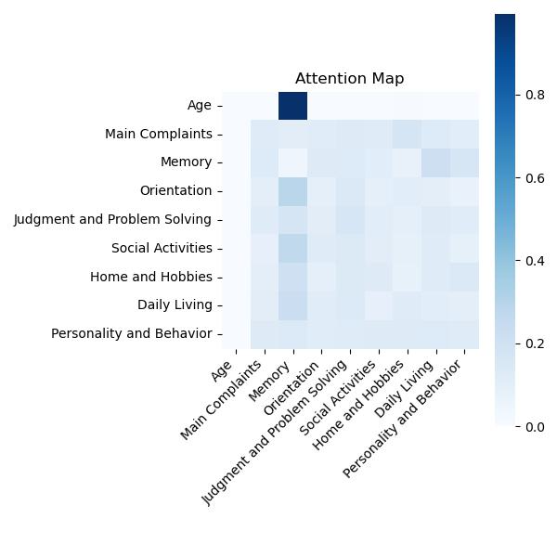
1. Preprocessing Background
“In the picture, we can see that the Age and Memory weights are high. ”
<Attention plot>

Slide 4
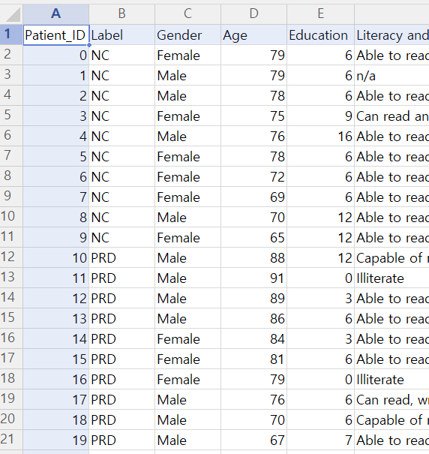
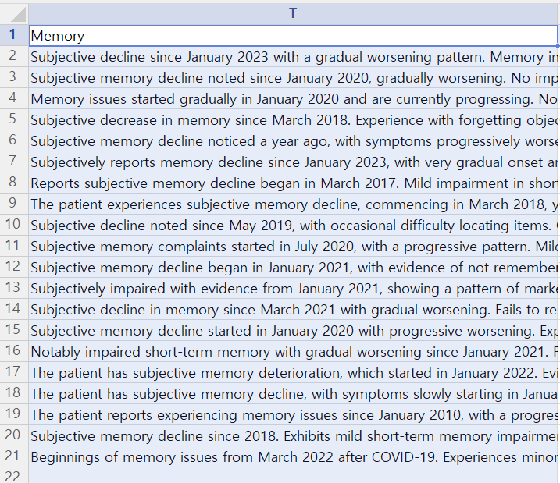
1. Preprocessing Background
“Standardized”

Slide 5
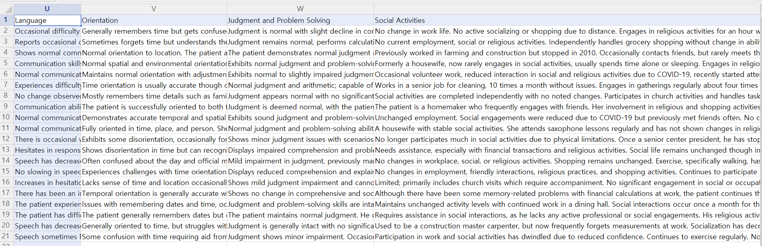
1. Preprocessing Background
“Unstandardized”

Slide 6


2. About Code
.hwp
Translate
LLM : extract
When reading a .hwp file in read_data.py, one category is read as the key value of the dictionary, and the text corresponding to the category is read as the value of the dictionary.
Standerdized “+”, “O” , “Y” → int 1 “-”, “X” , “N” → int 0
+

Slide 7
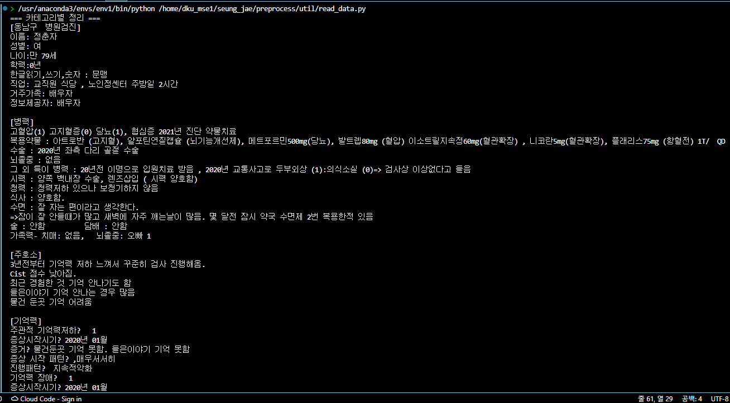
2. About Code - Result

Slide 8

2. About Code
.hwp
Translate
LLM : extract
“Through this data cleansing before extraction of LLM, more concise and standardized text output is possible.”
a function that translates by specifying a specific translation target key in the categories dictionary

Slide 9
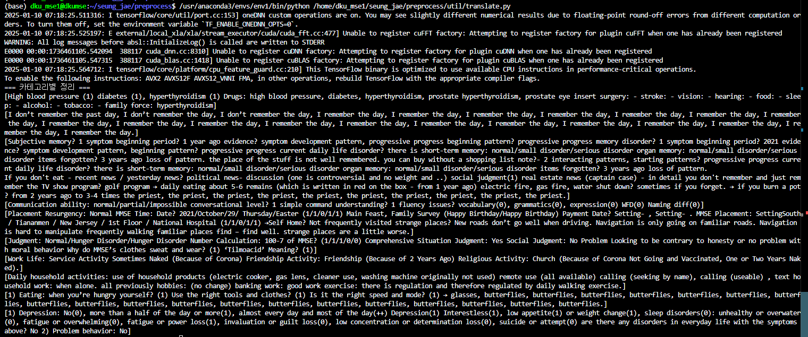
2. About Code - Result

Slide 10
3. Conclusion
<병력>
<주호소>
<지남력>
< >
∙ ∙ ∙
① Solved the problem that there are missing categories such as <병력> in the .hwp file.
② Since the contents do not need to be matched, delete the previous text and take only (-/-/-/-/+).

Slide 11

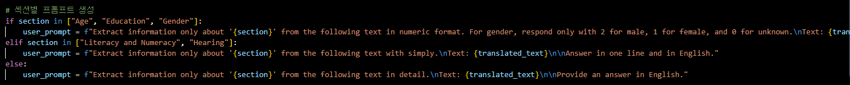
3. Conclusion
③ More in-depth section-specific prompts allow to create text that can help us determine whether patient have dementia or not.

Slide 12
3. Conclusion
Prompt
"Analyze the text for signs memory-related issues. Separate the analysis into short-term memory, long-term memory, and overall memory recall. Include examples or patterns indicating memory deterioration."
Since short-term memory loss is common in dementia, questions that focus on this
"Evaluate the patient's cognitive abilities and judgment based on the text. Look for difficulties in reasoning, problem-solving, decision-making, or understanding complex information."
Since Dementia is associated with cognitive decline and judgment problems.
"Identify any behavioral or emotional changes mentioned in the text. Include patterns like anxiety, mood swings, apathy, or socially inappropriate behavior, which might indicate dementia."
For dementia patients, anxiety, indifference, and inappropriate behavior may be signs of dementia.

